Slide 1

Object Oriented Javascript
May 2016

Slide 2
What Is JavaScript
JavaScript, aka Mocha, aka LiveScript, aka JScript, aka ECMAScript, is one of the world's most popular programming languages
It was created in May 1995 by Brendan Eich, then working at NetScape
JavaScript is a loosely typed language, which means you do not declare the data types of variables explicitly.
It is an interpreted object-oriented programming language.
JavaScript is the world’s most misunderstood programming language

Slide 3
Where is JavaScript used
JavaScript language has no concept of input or output.
It designed to run as a scripting language in a host environment, and it is up to the host environment to provide mechanisms for communicating with the outside world
Most common host environment is browser, But Javascript interpreters can also be found in many other places like,
Adobe Acrobat
Adobe Photoshop
server-side environments such as Node.js
NoSQL databases like the open source Apache CouchDB

Slide 4
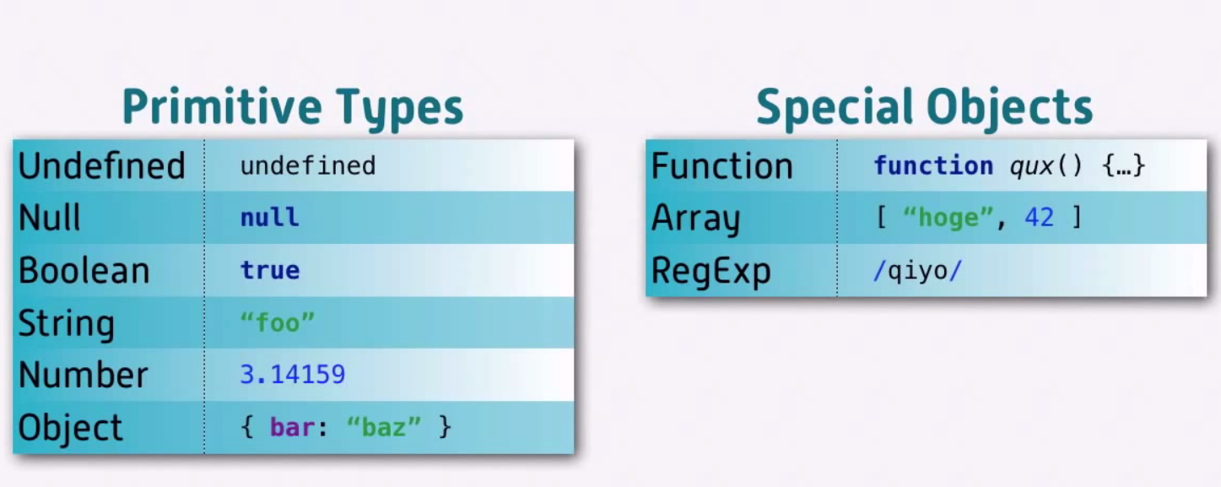
Data Types
null
Undefined
Number
String
Boolean
Object
Function
Array
RegExp

Slide 5
More on Data Types
Number
Numbers in JavaScript are "double-precision 64-bit format IEEE 754” values.
Watch out for stuff like 0.1 + 0.2 == 0.30000000000000004
There's a built-in object Math which has mathematical functions and constants like Math.sin(), Math.PI
A special value called NaN (short for "Not a Number") is returned if the string is non-numeric:
parseInt("hello", 10); returns NaN
If you provide NaN as an input to any mathematical operation the result will also be NaN:
NaN + 5; // NaN
There is an inbuilt function to check whether an input is NaN - isNaN(NaN) // true
JavaScript also has the special values Infinity and -Infinity:
1 / 0; // Infinity
-1 / 0; // -Infinity
null
It is a value that indicates a deliberate non-value
Notes:
Ithu veno?

Slide 6
More on Data Types
undefined
Indicates an uninitialized value.
Boolean
It has two possible values – true & false
Any value can be converted to Boolean according to the following rules:
false, 0, empty strings(“”), NaN, null and undefined all become false.
All other values become true
Boolean(“”); //false
Boolean(234); //true
Notes:
Ithu veno?

Slide 7
Variables And Scope
New variables in JavaScript are declared using the var keyword:
Variables are declared without a type [Loosely typed]
We can use typeof to find the type of data stored in a variable.
If you declare a variable without assigning any value to it, its type is undefined.
There is no block scope in JavaScript and only function scope.
With later version of JavaScript new keywords let and const declarations allow you to create block-scoped variables.

Slide 8
Data Types - typeof
Data Type | Result
null | Object
undefined | undefined
Number | number
String | string
Boolean | boolean
Object | object
Function | function
Array | object
RegExp | object

Slide 9
More on Scope
There are two scope in javascript
Global Scope (Window Object)
Local Scope (Inside a function)
If we declare a variable inside a function javascript will hoist that variable declaration to the top of the function, this is known as hoisting.
When we have nested functions js create a scope chain and then travels up this chain when looking for a variables value.

Slide 10
Operators
Operator | Values
Arithmetic | + | - | * | / | % | ++ | --
Assignment | = | += | -= | *= | /= | %=
String | = | +=
Comparison | == | === | != | !== | < | > | <= | >=
Conditional (Ternary) | variablename = (condition) ? val1:val2
Logical (Relational) | && | || | !
Bitwise | & | | | ~ | ^ | >> | << | >>>
typeof | typeof

Slide 11
More on Operators
The remainder operator returns the remainder left over when the first operand is divided by the second. It always takes the sign of the dividend not the divisor.
Eg : -1 % 2 // -1
The && and || operators can be used for
checking for null objects before accessing their attributes:
var name = o && o.getName();
setting default values:
var name = otherName || "default";
Ternary Operator
var allowed = (age > 18) ? "yes" : "no";
Equality Check
The double-equals operator does not consider types and may give unexpected results.
123 == "123"; // true
1 == true; // true

Slide 12
Control Structures
JavaScript has a similar set of control structures to other languages in the C family:
Conditional
if, if-else,
switch
Iterative
while
do-while
for
With
Inside the block, the properties of the object given to with act as variables.
Newly introduced variables are not added as properties to this object though.

Slide 13
Object Basics
JavaScript objects can be thought of as simple collections of name-value pairs.
There are two basic ways to create an empty object.
var obj = new Object();
var obj = {};
Both are semantically equivalent; the second is called object literal syntax, and is more convenient as its core ot JSON format.
Sample:
var student= {
name: "Max",
"number": 001,
marks: {
english: 80,
malayalam : 90
}
};
Attributes of an object can be accessed in two ways.
student.marks.english; //80
student["marks"]["english"]; // 80 – name of the property is provided as String and can be calculated at run time
We can dynamically add a new attribute like
obj.marks.hindi = 75;
Primitives are passed by value whereas objects are passed by reference.

Slide 14
Arrays
Arrays in JavaScript are actually a special type of object. They work very much like regular objects.
They have one additional property called 'length'. This is always one more than the highest index in the array.
Eg:
var a = new Array();
a[0] = "dog";
a[1] = "cat";
a[2] = "hen";
a.length; // 3
Iterate over array
Basic for loop
For each loop
For In loop (Not recommended for array as it iterates over all attributes and the order is not guaranteed).
There are a bunch of other operations that can be done on Array.
a.reverse() Reverses the array.
a.pop() Removes and returns the last item.
a.push(item1, ..., itemN) Adds one or more items to the end.
And Many more…….

Slide 15
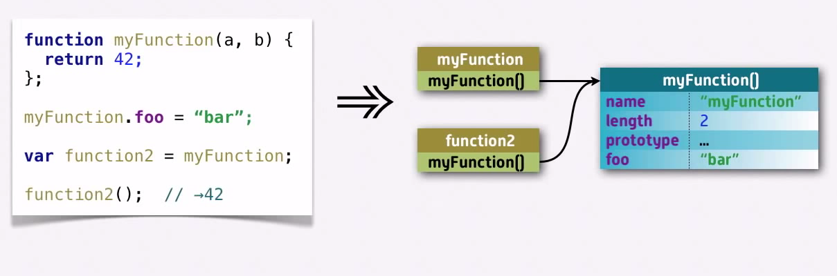
Functions
JavaScript functions are themselves objects like everything else in JavaScript — and you can add or change properties on them.
Functions can be named and also be anonymous.
We can store a function as a variable and pass to another functions just like any other objects
There is no function overloading in Java script.
We can pass in any number of parameters to a function.
Functions have access to an additional variable inside their body called arguments, which is an array-like object holding all of the values passed to the function.

Slide 16
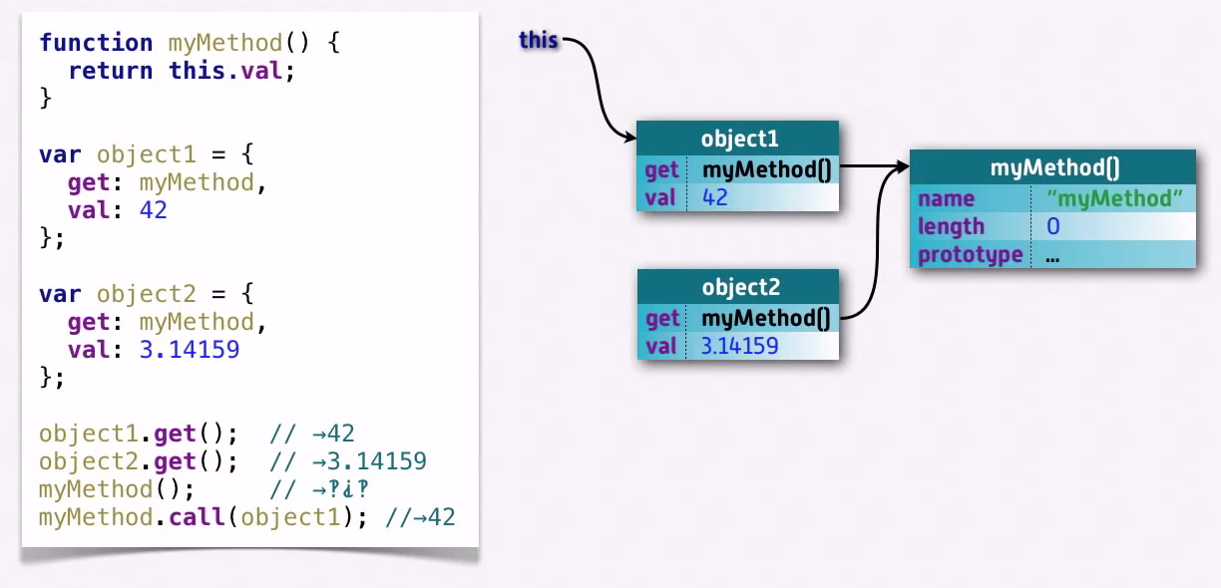
The this keyword
It depends on the object and not where the function is defined.
To set this to a particular object we can use call , apply or bind.
Following is a sample using call.

Slide 17
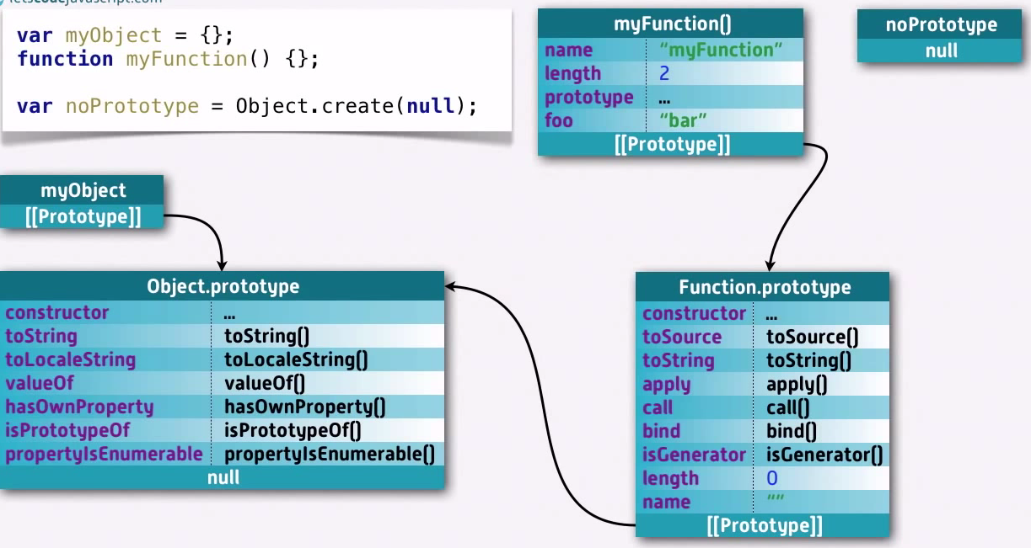
What is Prototype
Every single object has a prototype except for the base object and the object we create to not have a prototype.
Default methods and methods like call and apply reside over here.

Slide 18
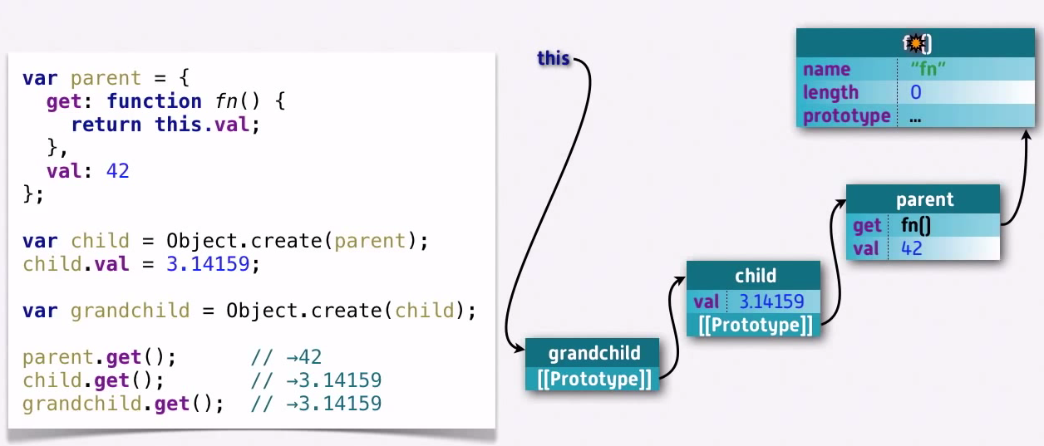
Prototypal Inheritance
This is the fundamental way of inheritance provided by JavaScript.
Following is a simple example:

Slide 19
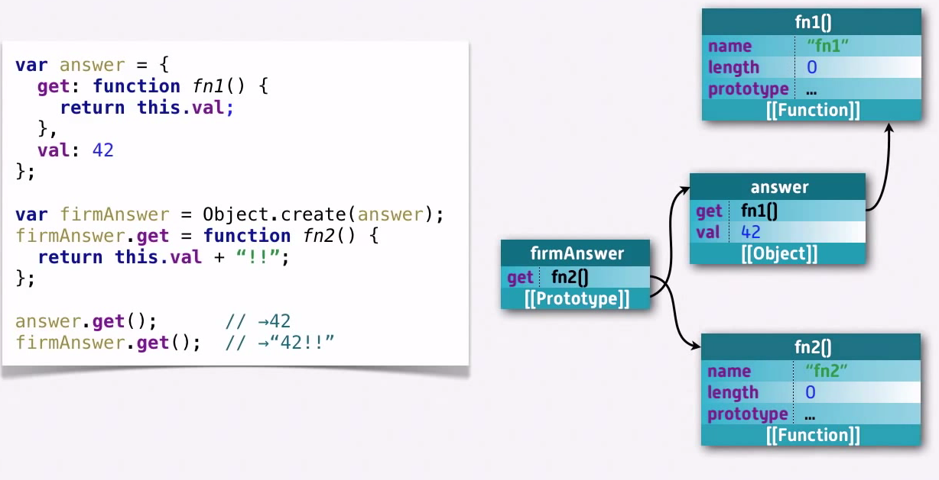
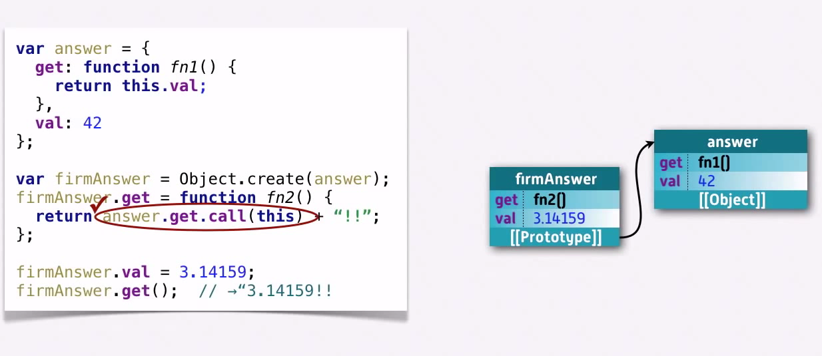
Polymorphism And Method Overriding

Slide 20
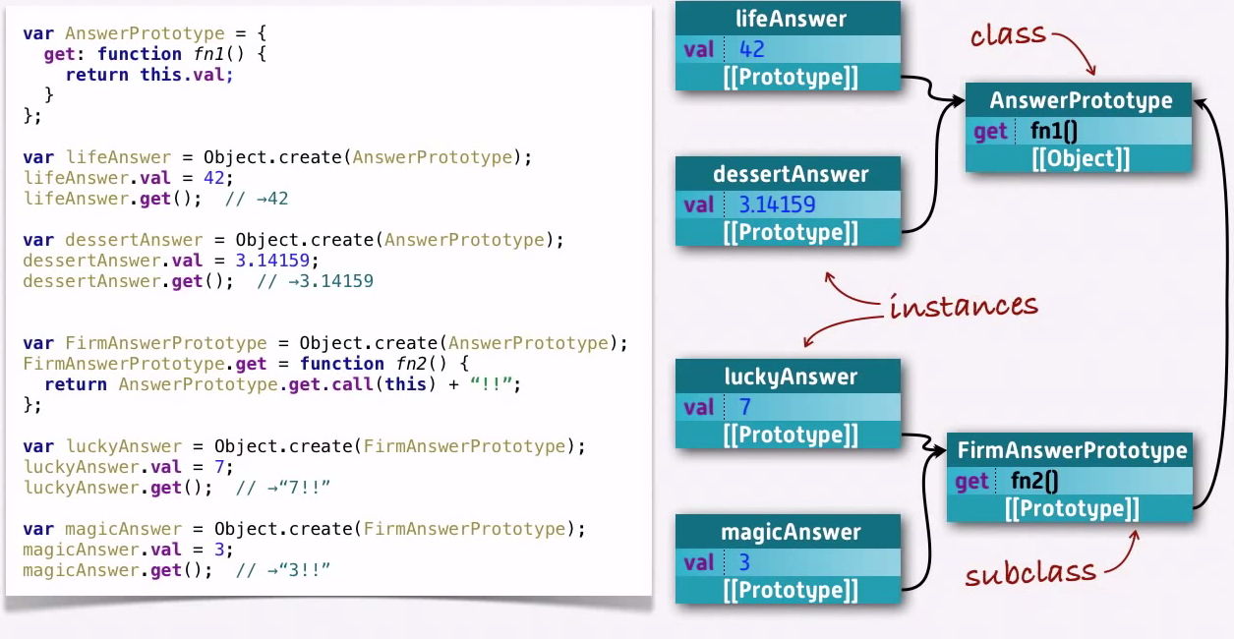
Classes And Instances
Normally we separate the methods from the data.
Instances are usually about the data and classes are about the methods

Slide 21
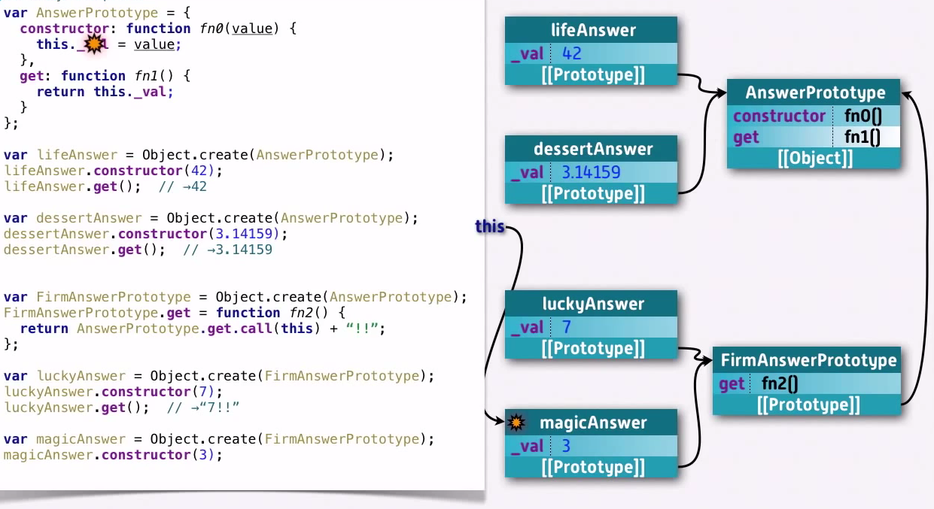
Constructors
In the previous example initialization logic resides in the instances which is duplicate logic and violated encapsulation.
We add initialization logic in the classes and usually such methods are called constructors
This is the complete view of prototypal inheritance in JavaScript.

Slide 22
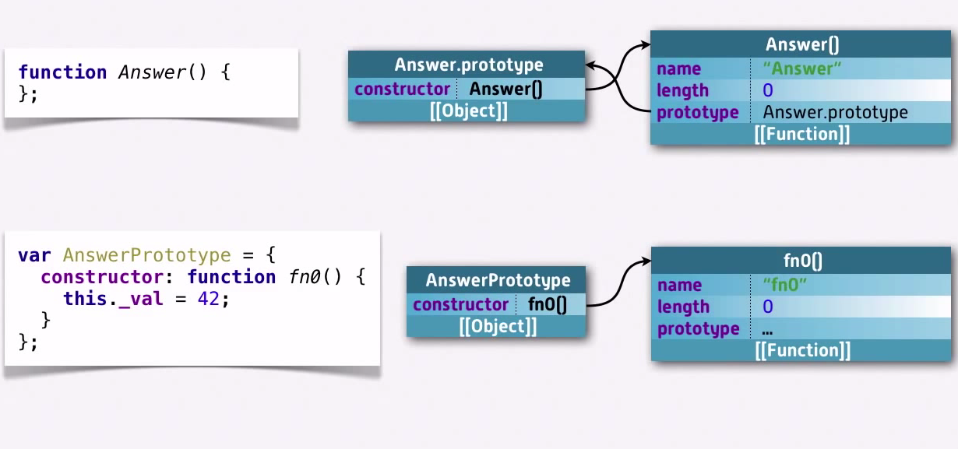
Prototype Property of function
Whenever we create a function in JavaScript we are creating two object.
Function Object itself
Prototype object
This creates the same structure as the previous example.
By convention we use Caps for a function if its meant to be a class.

Slide 23
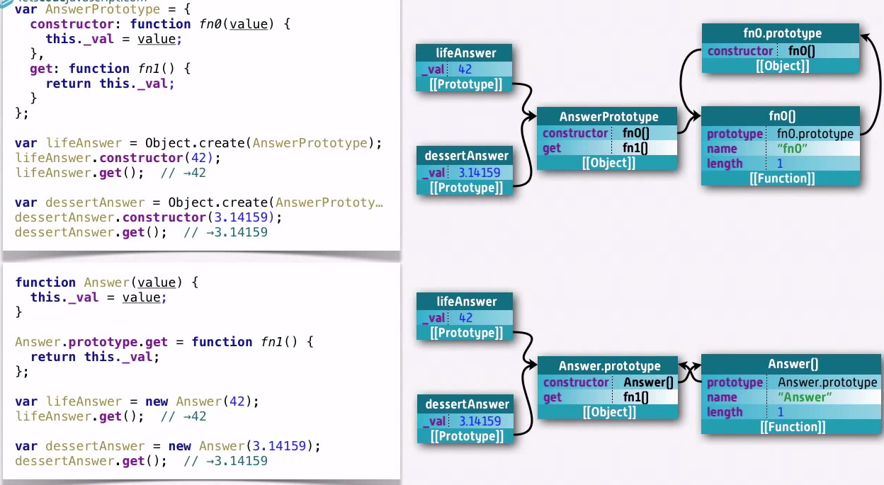
Classical Model
The Classical model is the most popular method of inheritance in JavaScript.
It make use of the property attribute of the function and the “new” keyword.
The way JS knows to create lifeAnswer with Answer.prototype as its prototype is because it looks at the prototype property of the constructor when we use the new keyword.

Slide 24
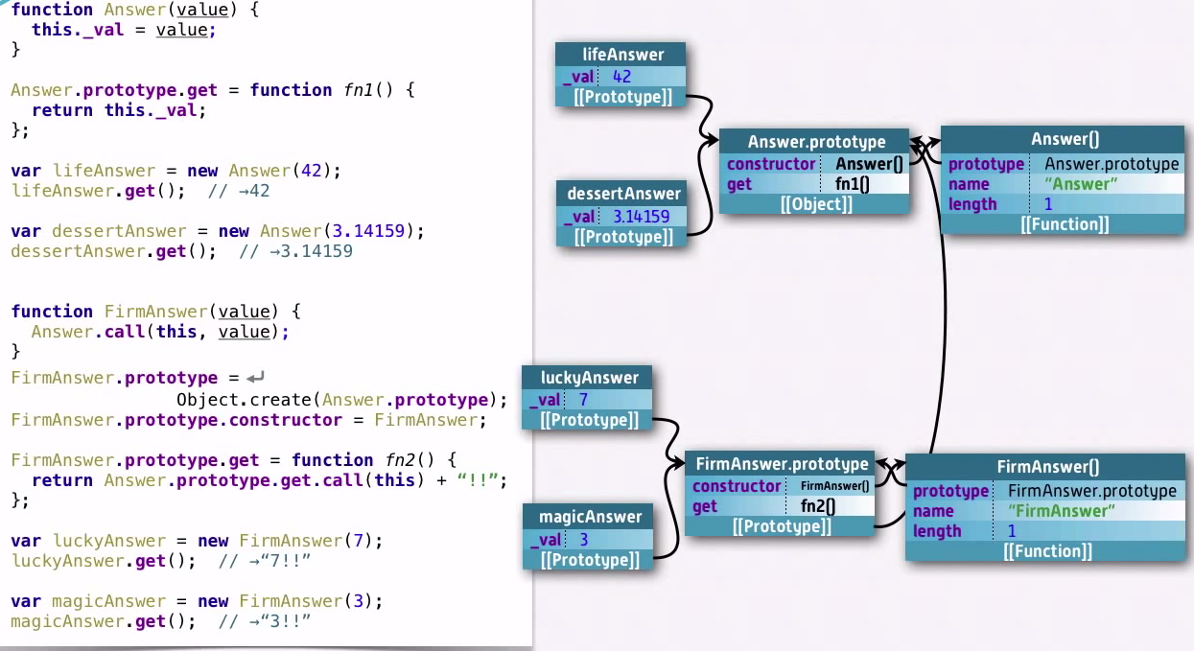
Classical Model with subclass
When we create the sub class using classical model we need the sub class prototype to extend from the super class prototype.
By default when the sub class is created an object which does not extend from any other class is created and set as prototype.
So we need to explicitly create the prototype object and set it.

Slide 25
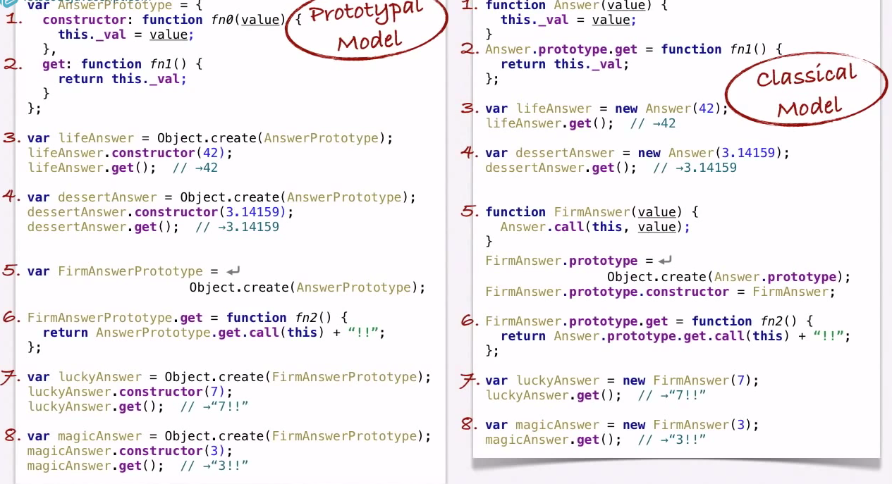
Prototypal Vs Classical

Slide 26
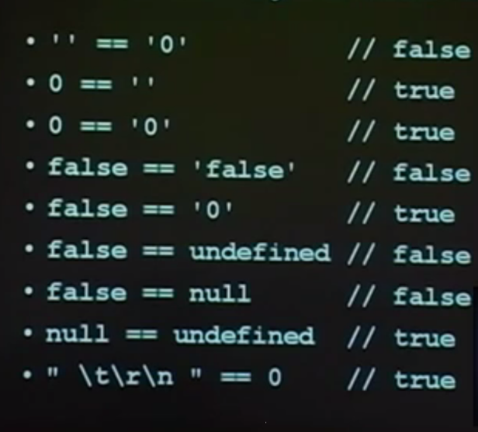
Always Use ===

Slide 27
Closures
A closure is a special kind of object that combines two things: a function, and the environment in which that function was created.
Function body has access to variables declared outside the function body.
Nested function and variables may continue to live even after the outer one has finished execution.
A closure in JavaScript is like keeping a copy of all the local variables, just as they were when a function exited.
Example:
function person(name){
var _name = name;
this.getName = function(){
return _name;
}
}
It very helpful in event driven environments like browser where we need to bind an event listener.

Slide 28
Intro to JQuery
A free open source Js library.
It simplifies many common web development tasks like AJAX, Animation etc.
It simplifies the cross browser issues
Uses statement chaining and make the code compact and easier to use.
Highly extensible and used widely to create many plugins.
$ is the short hand way to call the jquery function, we can also use jQuery also

Slide 29
Selectors And Filters
Selectors
Selectors are used to select parts of webpage using a common css syntax
Eg: $(“p”) will select all the parahraph tags.
$(‘#id’) -- > unique element with Id
$(.className) -- > All elements with the class name
Filters
Filters are used to further refine the results returned from selectors.
Eg : $(“p:first”); will select first paragraph
There are large number of modifications done on the selected parts using several jQuery functions like:
Hiding the element
Injecting and Html
Changing the Css
And much more…..

Slide 30
Ajax using JQuery
Ajax is widely used in single page applications.
Using Ajax we need not reload the entire page.
Jquery makes Ajax calls very simple
2 Types of ajax calls:
$.ajax(); // Perform general Ajax operations
$("#id").load() // Loads the content in the response directly to the selected element

Slide 31
Including JQuery Plugins in web Application

Slide 32
Thank You

